Slide 1

Sip Servlets
Dima Ionut Daniel

Slide 2
Contents
What is SIP?
What is SIP Servlet?
SIP Architecture
SIP Entities
SIP Services
SIP Protocol
SIP Message
SIP Servlet Core
SIP Servlet Deployment
SIP Servlet Implementations
Mobicents SIP Servlet
Conclussion
Bibliography

Slide 3

What is SIP?
The Session Initiation Protocol (SIP) is a signaling communications protocol, used for controlling multimedia communication sessions such as voice and video calls over Internet Protocol (IP) networks.
SIP has been developed and standardized in RFC 3261 under the auspices of the Internet Engineering Task Force (IETF).
SIP can be used for two-party (unicast) or multiparty (multicast) sessions.
The protocol defines the messages that are sent between endpoints, which govern establishment, termination and other essential elements of a call.

Slide 4
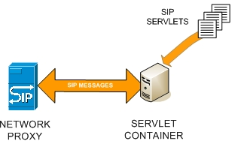
What is SIP Servlet?
A SIP servlet(JSR 309) is a Java programming language server-side component that performs SIP signaling.
SIP servlets are managed by a SIP servlet container, which typically are part of a SIP-enabled application server.
SIP servlets interact with clients by responding to incoming SIP requests and returning corresponding SIP responses.
SIP servlets are built using the the generic servlet API provided by the Java Servlet Specification.

Slide 5
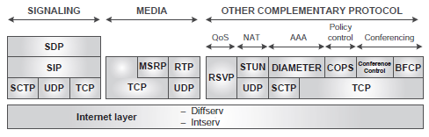
SIP Architecture
Multimedia communication is enabled in the Internet by IP-based application-level protocols.
There are 2 types of protocols form the core of multimedia communication systems:
The signaling protocols
The media transport protocols

Slide 6
SIP Architecture (cont.)
Signaling:
The core signaling protocol for multimedia communication is the Session Initiation Protocol.
SIP works in with the Session Description Protocol.
SIP deals with the session-management issues;.
SDP is responsible for session description.
The SDP messages are transported in the body of SIP messages.
SDP offers a generic mechanism to describe multimedia sessions.

Slide 7
SIP Architecture (cont.)
The core protocols used for media transport are:
Real-time Transport Protocol (RTP).
Message Session Relay Protocol (MSRP) .
Transmission Control Protocol (TCP) .
RTP is typically used to carry pure real-time media, such as voice or video.

Slide 8
SIP Entities
SIP basically solves two key aspects in IP multimedia communications:
Session setup, modification, and termination
Location of users
The SIP specifications define a number of SIP elements as part of the SIP architecture:
User Agents (UAs)
Registrars
Proxies
Back-to-Back User Agents (B2BUAs)

Slide 9
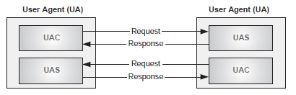
SIP Entities (cont.)
User Agents are typically located at the SIP endpoints.
A SIP UA has two components:
User Agent Client (UAC) → responsible for the generation of new SIP requests and the reception of the associated responses.
User Agent Server (UAS) → responsible for receiving SIP requests and generating the appropriate responses

Slide 10
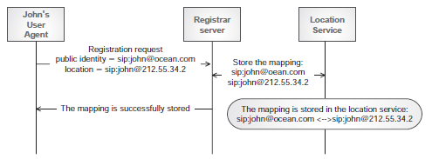
SIP Entities (cont.)
A registrar is a server that accepts registration requests from the User Agents.
The registration is the process by which a SIP UA communicates its current location along with its externally visible identifier to the registrar server.
A SIP UA needs to be registered before it can receive multimedia calls.
The Location Service is not a SIP entity.
A Location Service is a database that contains a list of mappings between Addresses of Record (AORs), which represent public SIP identities, and Contact Addresses (which represent the user location) for a specific domain.
AORs and Contact Addresses are expressed as SIP URIs.

Slide 11
SIP Entities (cont.)
Proxies are also useful for enforcing policy (for example, making sure a user is allowed to make a call).
A proxy server is an intermediary entity and are performing SIP routing
outbound → helps the UAs to route outgoing requests.
inbound → handles incoming requests for an administrative domain.

Slide 12
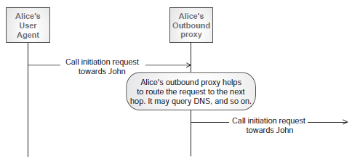
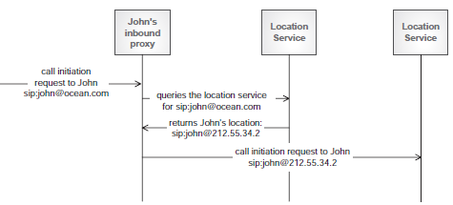
SIP Entities (cont.)
An outbound proxy helps the UAs to route outgoing requests. .
An inbound proxy is a proxy server that handles incoming requests for an administrative domain.

Slide 13
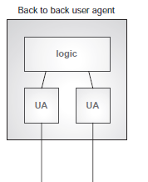
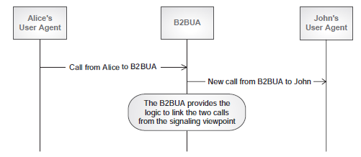
SIP Entities (cont.)
A B2BUA is a logical entity that acts as a User Agent to both ends of a SIP call.
They are responsible for handling all SIP signaling between both ends of the call, from call establishment to termination.
They remain in the call path for the complete duration of the call.

Slide 14
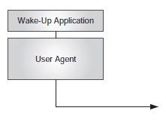
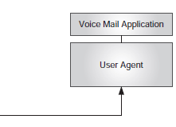
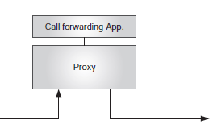
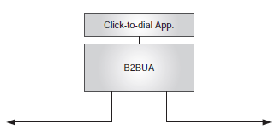
SIP Services
A SIP service is an application on top of a SIP entity that delivers an enhanced functionality.
Depending on the requested functionality, SIP services may sit on top of a User Agent (UA), a proxy, or a Back-to-Back User Agent (B2BUA).
A Click-to-Dial (CTD) service, where a user who is browsing on a web site that sells “something ” can click on a “customer care” link and have the server automatically establish a call between that user and the customer-care center.

Slide 15
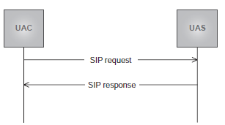
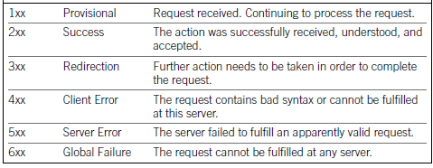
SIP Protocol
SIP operation is based on the exchange of SIP messages.
A SIP request, together with all the responses associated with it, is called a transaction.
SIP defines response codes that are set to responses.

Slide 16
SIP Protocol (cont.)
RFC 3261 defines 6 types of SIP requests, so-called methods:
REGISTER
INVITE
ACK
CANCEL
BYE
OPTIONS
SIP extensions documented in other RFCs may define additional methods.

Slide 17
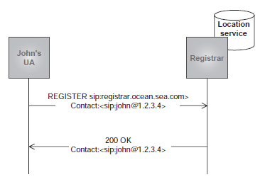
SIP Protocol (cont.)
REGISTER:
This method is used by a User Agent in order to perform the registration procedure.
It allows the UA to associate its public identity, the so-called Address of Record (AOR), to its current location, called Contact Address, from which the IP address can be easily obtained.

Slide 18
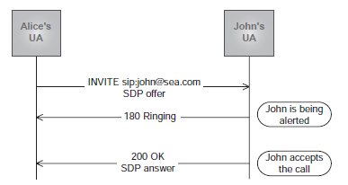
SIP Protocol (cont.)
INVITE:
A UAC generates an INVITE method in order to initiate a session with a UAS.
The request will contain the public identity, as a SIP URI, of the user to which the request is addressed in a field called Request-URI.
The request can go directly from UAC to UAS, or may traverse one or more proxies, which can then assist in the routing of the request.

Slide 19
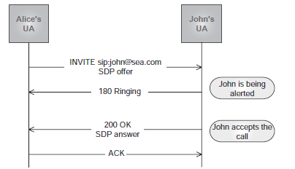
SIP Protocol (cont.)
ACK
The INVITE transaction is the only transaction in SIP that uses a three-way handshake, as opposed to a two-way handshake used by the rest.

Slide 20
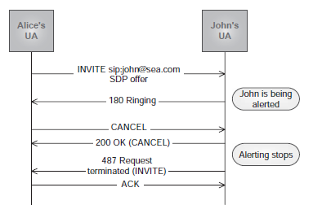
SIP Protocol (cont.)
CANCEL
A UAC generates a CANCEL request in order to cancel a pending request. The
CANCEL request is part of a different transaction, but it refers to the original transaction.
The reception of a CANCEL request causes the UAs to stop processing the pending transaction.
When a CANCEL request is received for a transaction that is already completed, it has no effect.

Slide 21
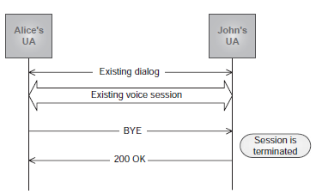
SIP Protocol (cont.)
BYE
The BYE request is used to terminate a session.
When a UAS receives a BYE request for an existing dialog, the UAS must terminate the session associated with that dialog.

Slide 22
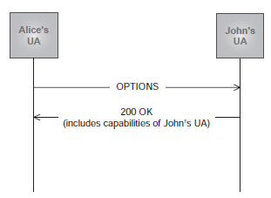
SIP Protocol (cont.)
OPTIONS
The OPTIONS request allows a UA to query a server about its capabilities.
These capabilities include information about the supported methods, content types, extensions, codecs, and so on.

Slide 23
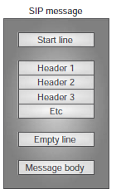
SIP Message
SIP is a text-based protocol.
SIP messages are divided into lines of characters.
A line is a series of characters that is delimited with the two characters Carriage Return and Line Feed (CRLF).
There are two types of SIP messages:
requests
responses.

Slide 24
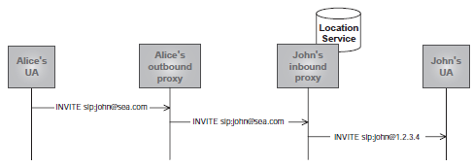
SIP Message (cont.)
In SIP requests, the start line is called a request line, and contains a method name, a Request-URI, and the protocol version, all them separated by a single space character.
Method <SP> Request-URI <SP> Protocol-version
In SIP responses, the start line is called a status line, and consists of the protocol version followed by a numeric status code and its associated reason phrase
Protocol-version <SP> Status-Code <SP> Reason-phrase

Slide 25

SIP Message (cont.)
SIP Header Fields are after the start line in requests and responses.
They provide information about the request or response and about the body it contains.
Each header field consists of a field name followed by a colon (:) and the field value

Slide 26
SIP Message (cont.)
The From header field indicates the logical identity of the initiator of the request.
The To header field specifies the logical recipient of the request.
These logical identities are typically expressed as a SIP URI.
The Call-ID header field acts as a unique identifier to group together a series of messages.
It is generated by the UA as a combination of a random string and the UA ’ s host name or IP address.
The combination of the To tag, From tag, and Call-ID completely identifies a dialog.
The Call-ID must be the same for all requests and responses sent within a dialog.
The Via header field indicates the path taken by the request so far, and so expresses the path that should be followed in routing the responses.

Slide 27
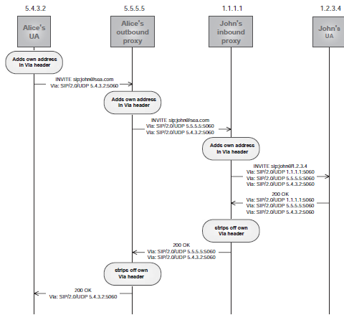
SIP Message (cont.)

Slide 28
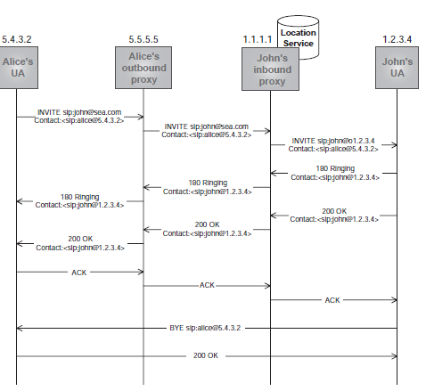
SIP Message (cont.)
The Contact header field is generated by a UA, and provides a SIP URI that can be used to contact that specific instance of the UA for subsequent requests.

Slide 29
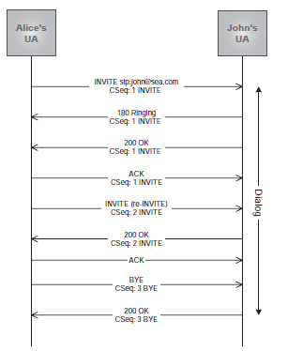
SIP Message (cont.)
The Command Sequence (CSeq) header field consists of a sequence number and a method(Example: CSeq: 5 INVITE).
The sequence number is used to order end-to-end requests within the same dialog.
A UA generating requests within a dialog must increment by 1 the value of the sequence number in all subsequent end-to-end requests it sends.
The ACK and CANCEL requests do not cause the sequence number to be incremented.

Slide 30
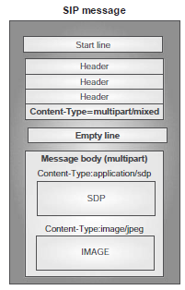
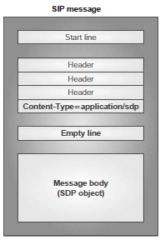
SIP Message (cont.)
SIP requests and responses may contain message bodies of different Internet media types.
The message body in a SIP message is an SDP session description, but it may consist of any object, such as a photo or image.
In order to qualify the message body, a number of SIP headers are defined:
Content-Type
Content-Length
Content-Encoding
Content-Disposition

Slide 31
SIP Servlet Core
A SIP servlet extends the javax.servlet.sip.SipServlet class, optionally overriding SipServlet's methods.
These methods correspond to the SIP protocol's requests, and are named doRequest where Request is a SIP request name.
For example, the doRegister method will respond to incoming SIP REGISTER requests.

Slide 32
SIP Servlet Core (cont.)
SIP Servlet 1.1 defines four annotations that may be used in SIP applications.
Using these annotations simplifies SIP application development by making the sip.xml deployment descriptor optional.
@SipServlet → Marks the class as a SIP servlet.
@SipListener → Marks the class as an implementation class of one of the SIP listeners.
@SipApplication → An application-level class to define a collection of SIP servlets.
@SipApplicationKey → Associates an incoming request and SIP session with a particular SipApplicationSession.

Slide 33

SIP Servlet Core (cont.)
The javax.servlet.sip.SipFactory interface can be retrieved as bellow.
SIP applications use the container's SipFactory instance to create :
Requests using the createRequest methods.
Address objects such as URI, SipURI, Address, and Parameterable instances.
Application sessions.

Slide 34
SIP Servlet Core (cont.)
SIP sessions allow SIP servlets to associate SIP messages with data stored by the SIP container.
The javax.servlet.sip.SipSession interface is SIP the equivalent of javax.servlet.http.HttpSession interface.
Instances of SipSession store SIP session data and associate SIP user-agents so that they may communicate in a multiple-request dialog.
The javax.servlet.sip.SipApplicationSession interface defines methods for storing protocol information for both SIP and other protocols (for example, HTTP), and storing session data for the entire application.

Slide 35
SIP Servlet Core (cont.)
SIP application listeners are Java servlet application listeners that listen for SIP-specific events.
SIP Application session interfaces : SipApplicationSessionListener, SipApplicationSessionAttributeListener, SipApplicationSessionBindingListener, SipApplicationSessionActivationListener.
SIP Session interfaces: SipSessionListener, SipSessionActivationListener, SipSessionAttributeListener, SipSessionBindingListener.
SIP Error interface: SipErrorListener.
SIP Timer interface: TimerListener.

Slide 36
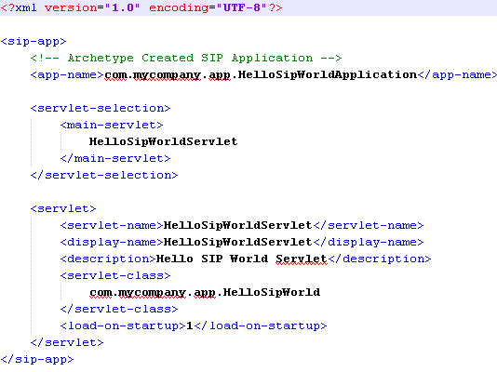
SIP Servlet Core (cont.)
The optional sip.xml deployment descriptor is used by the SIP servlet container to process deployed SIP applications and configure the runtime to properly respond to incoming SIP requests.
Sample sip.xml descriptor:

Slide 37
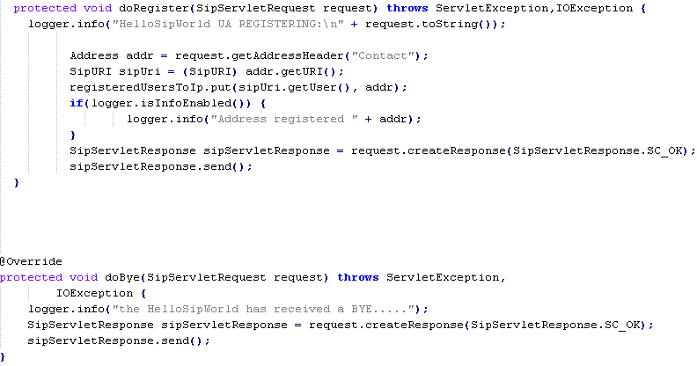
SIP Servlet Core (cont.)
Example of a doRegister and doBye methods implementation:

Slide 38
SIP Servlet Deployment
SIP applications are packaged in either SAR (SIP archive) or WAR (web archive) files.
These archives are standard Java archives (JAR).
The SAR format is similar to and based on the WAR format, including the use of the presence of the WEB-INF folder that contains class files and deployment descriptors.
SIP containers will recognize either the .sar or .war extensions when processing SIP applications.

Slide 39
SIP Servlet Implementations
SIP Servlet Implementations and SIP containers:
Mobicents Sip Servlet (based on Tomcat or Jboss container)
Sailfin(based on Glassfish container)
Cipango(based on Jetty container)
Jiplet(based on Jboss container)

Slide 40
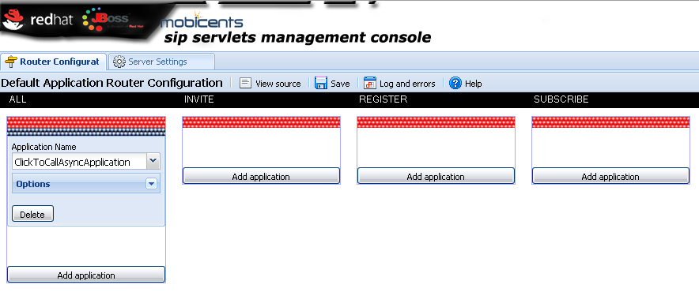
Mobicents SIP Servlet
The Mobicents SIP Servlets Server is a certified implementation of the SIP Servlet v1.1 (JSR 289) specification that can run on top of either the JBoss Application Server or the Tomcat Servlet Container.
The MSS for JBoss or MSS for Tomcat instance can be accessed and configured using the SIP Servlets Management Console.
The management console is available at http://localhost:8080/sip-servlets-management/.

Slide 41
Mobicents SIP Servlet (cont.)
The MSS for JBoss or MSS for Tomcat instance will listen on port 5080 for SIP messages.
The configuration can be found in conf/server.xml file.
Properties used for SIP stack can be found in conf/mss-sip-stack.properties file.
The default application routing(DAR) for SIP can be found in conf/dars/mobicents-dar.properties file.
Application Routing is performed within the Mobicents Sip Servlets container by the Default Application Router.
The Application Router is called by the container to select a SIP Servlet application to service an initial request.

Slide 42
Conclussion
SIP Servlet is used in a Java EE envirnoment.
SIP Servlet adds voice to Java EE applications.
SIP Servlet is documented.

Slide 43

Bibliography
http://en.wikipedia.org/wiki/Session_Initiation_Protocol
Internet Multimedia Communications Using SIP
https://docs.oracle.com/cd/E19355-01/820-3007/index.html

Slide 44
Questions ?

